Slide 1
V5R2
V1R1
Li Fengyu (Employee ID: wx352239)
Mar 01, 2019
New

Slide 2
Cloud Computing Trends

Slide 3
Cloud computing has become the foundation of a range of important applications. At the same time, other technologies are also driving the further advancement of cloud computing. This chapter focuses on the relationship between cloud computing and related fields, and introduces you to some of the new technologies related to cloud computing.

Slide 4
Upon completion of this course, you will:
  Be able to describe key technologies that underpin cloud computing.
  Understand the relationship between cloud computing and other fields.
  Understand some of the most prominent cloud computing trends.

Slide 5
Fields Related to Cloud Computing
Cloud Computing Technologies
Cloud Computing Trends
Other Emerging Technologies

Slide 6
IoT
The Internet of Things (IoT) is the concept of connecting everything through the Internet, including all sorts of communication and interaction: people-people, people-things, and things-things.
Internet
Of things

Slide 7
Main IoT Technologies
RFID
BILL
Sensors
Embedded Systems
$
$

Slide 8
Big Data
Big data refers to data sets that are too large or complex to be handled by traditional data-processing application software.
Such data sets are generated by the IoT. Due to a radical increase in total IoT connections, ever more massive data sets will be generated.

Slide 9
Characteristics of Big Data
Volume: the amount of data
Variety: the different types of data
Velocity: the speed at which data is generated
Value: the value that can be extracted from data

Slide 10
Big Data Processing
Collect
Transmit
Store
Process
Analyze
Search
Mine
Use
Data
Collect
Cleanse
Intelligence
Information
Use
Associate
Knowledge

Slide 11

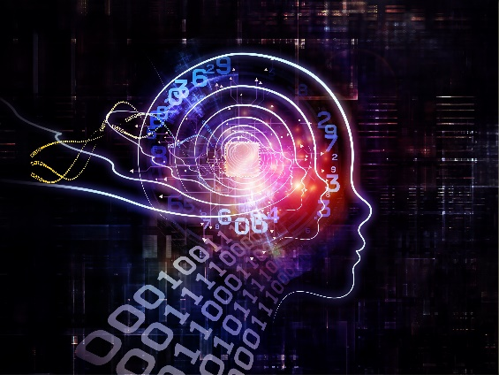
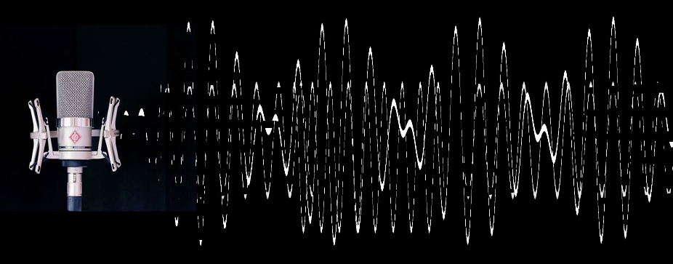
Artificial Intelligence
Artificial intelligence (AI) is an area of computer science that focuses on the research into and development of theories, methodology, technology, and application systems for simulating and extending human intelligence with machines.
Applications of AI include robotics, speech recognition, image recognition, natural language processing.

Slide 12
Elements of AI
Big Data
Computing Power
Computing power is a prerequisite for applying AI algorithms to extract value from massive data sets.
Artificial intelligence is intelligence acquired and summarized by big data analytics.
Algorithms
Scenario
Algorithms are the fundamental way by which AI is realized, and an effective method to extract data intelligence.
Big data, computing power, and algorithms are input that will create meaningful output only if applied to practical business scenarios.

Slide 13
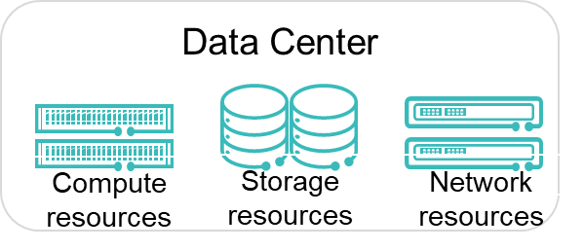
Cloud Computing, IoT, & Big Data
IoT
Virtual auditory system
Audio collector
Traditional Internet
Virtual visual system
Big data
Video collector
Virtual sensing system
Air, water, and soil sensors
Virtual motion system
Office equipment
Cloud computing
Mobile Internet
Virtual motion system
Household appliances
Production equipment
Virtual motion system

Slide 14
The 5G Era
5G refers to the 5th generation of mobile communications technologies and standards.
Massive number of connections
Enhanced mobile broadband
Reliable, low-latency

Slide 15
How 5G Works: Network Densification
4G
5G

Slide 16
Fields Related to Cloud Computing
Cloud Computing Technologies
Cloud Computing Trends
Other Emerging Technologies

Slide 17

Containers
Containerization is a lightweight virtualization technology that uses OS-level virtualization. Several containers (isolated user-space instances) can be created on each operating system, each of which is allocated only a subset of the computer's resources.

Slide 18

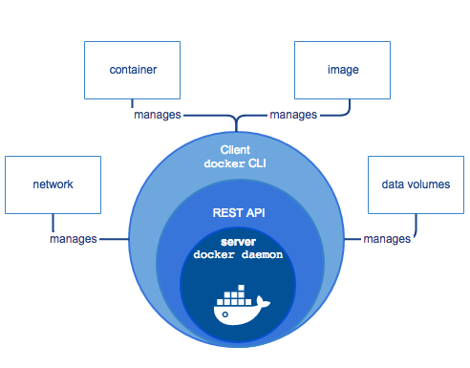
Docker
Docker is an open source application container engine. It allows developers to pack their applications and dependency packages into a portable container, and later run them on any other Linux machine. The sandbox mechanism is used for containers, eliminating any interface between containers.

Slide 19
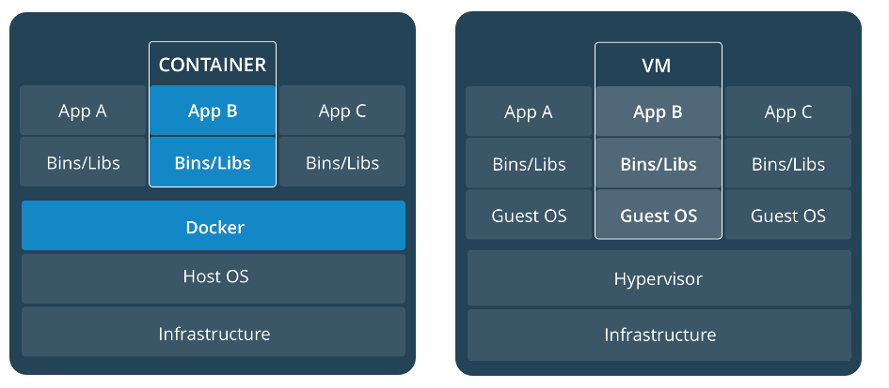
Docker Technology - Differences Between Containers and VMs (1)

Slide 20
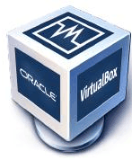
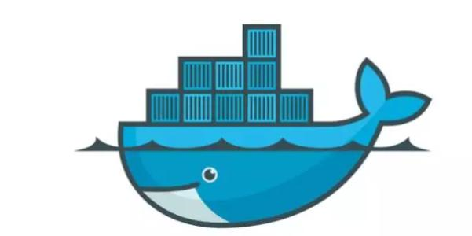
Docker Technology - Differences Between Containers and VMs (2)
Difference | VM | Docker
Size
Boot speed
Integration

Slide 21
Docker Elements
Image
  A Docker image is a read-only template used to create Docker containers. Docker provides a simple mechanism to allow users to create images or update existing ones. Users can also download images created by others and use them without making any changes.
Container
  Docker uses containers to run applications. A container is a runtime instance of a docker image. A container can be started, started, stopped, and deleted. Each container is an isolated and secure platform.
Repository
  A repository is a set of Docker images. A Registry is a hosted service containing repositories of images. Each image has a unique tag.

Slide 22
Docker Architecture
Host
Registry
Docker daemon
repository 1
Docker Client
Image 1
container 1
Image 1
Image 3
container 2a
Image 2
repository 2
container 2b
Image 2
Image 4

Slide 23
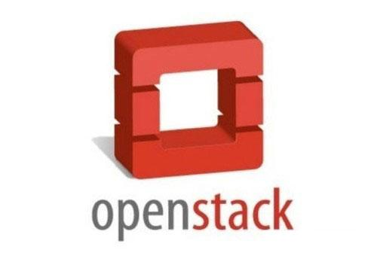
OpenStack
Began in 2010 as a joint project of Rackspace Hosting and NASA, OpenStack is a free open-source software platform for cloud computing. OpenStack requires contributions to be released under the Apache 2.0 license.
OpenStack is a free open-source software platform for cloud computing.

Slide 24
OpenStack Components
Nova
Swift
Cinder
Compute
Object Storage
Block Storage
Neutron
Keystone
Ceilometer
Network
Authentication
Metering
Glance
Heat
Horizon
Image
Orchestration
Dashboard
(UI Console)

Slide 25
Fields Related to Cloud Computing
Cloud Computing Technologies
Cloud Computing Trends
Other Emerging Technologies

Slide 26
Cloud Computing Trends
Cloud giants are strengthening cooperation, leading to a more concentrated market.
Cloud providers are using more AI.
Hybrid cloud and industry cloud are gaining momentum.
There is an emerging trend toward cloud-device integration.

Slide 27
Fields Related to Cloud Computing
Cloud Computing Technologies
Cloud Computing Trends
Other Emerging Technologies

Slide 28
Cloud Computing Extensions
Edge Computing
Network Congestion
Latency
Fog Computing
Security

Slide 29
Fog Computing
Fog computing is an extension of cloud computing services to the edge of the network to decrease latency and network congestion. Fog computing uses edge devices to carry out a substantial amount of computation, storage, and communication locally, instead of storing all data in cloud data centers.
Cloud DC
Core Network
Fog
Fog

Slide 30
Edge Computing (1)
Edge computing creates an open platform that integrates core capabilities including network, compute, storage, and applications at the edge of your network, to process data where it is being generated.
Cloud DC

Slide 31
Edge Computing (2)
Bandwidth/Server Access Frequency
Low latency
Edge Computing
ITS
Smart Transportation
HD video, bandwidth-intensive
Gaming
IoT/M2M
Cloud Computing
HD Images
Video Surveillance
Transmission network efficiency
Smart Home
Web
Services
High-quality user experience
Web Search
Storage
SNS
Timeliness

Slide 32
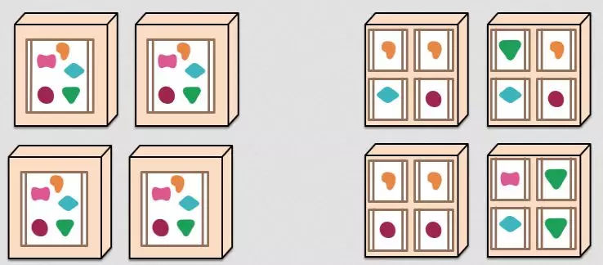
Microservices
Microservices are a software development technique that structures an application as a collection of loosely coupled, fine-grained services. In a microservices architecture, lightweight communication protocols are used, often HTTP resource APIs. The services are built around functionalities and deployed independently and in a fully automated manner. The need for centralized management is minimized. The services can be written in different languages and use different storage types.

Slide 33
Pros and Cons of Microservices
Pros
Cons
Independent deployment, flexible scalability
Effective resource isolation
Optimized development teams
Complex development and testing process due to project splitting
Difficulty of ensuring data consistency between services

Slide 34
Serverless (1)
Serverless computing is a model for building and managing microservices-based architectures. It allows you to manage your application deployment on a per-service level, rather than a per-server level.
  Function as a Service (FaaS): The service provider provides a platform where the developer develops, runs, and manages their applications without the need to build and maintain an infrastructure.
  Backend as a Service (BaaS): The service provider provides a serverless backend, also known as backend as a service for the mobile application developer. BaaS shifts backend functions including data/file storage, account management, data collection, operation analysis, message push, and social media integration to the cloud, allowing the developer to focus on their apps’ frontend.

Slide 35
Serverless (2)
Previously
Build a framework that runs on a server to respond to multiple events.
Now
Build or use a separate microservice or function to respond to each event.
Users don’t have to worry about physical resources.
Users don’t have to worry about middleware.
Users don’t have to worry about the backend.
IDC
IaaS
PaaS
BaaS/FaaS

Slide 36
FaaS Characteristics
Able to focus on the code
Quick boot,
short life cycle
No need for O&M
Infinite elasticity
Automated

Slide 37
BaaS Benefits
Faster TTM
Allows developers to focus on their apps rather than backend functions, and reduces operational costs of apps after launching.
Higher Efficiency
Reduces costs associated with mobile application development environments and improves efficiency.
Reduce Resources Needed to Launch Apps
Fewer developers and IT resources are required.
Optimized for Mobile Phones and Tablets
BaaS providers have spent a considerable amount of time and resources on optimizing mobile application data and networks.
Secure and Elastic Infrastructure
BaaS provides bundled infrastructure services, relieving developers of the burden of ensuring elasticity, security, and performance.
A Full Collection of Common APIs
BaaS offers a full collection of commonly used third-party APIs, sparing developers the hassle of collecting these resources.

Slide 38
Which of the following is not an element of artificial intelligence? ( )
A. Big data
  B. Cognitive analysis capability
  C. Computing power
  D. Scenario
The only function of the Internet of Things is to collect the data generated by connected objects.
A. True
B. False
Notes:
参考答案：
BD。
B。

Slide 39
Fields Related to Cloud Computing
Cloud Computing Technologies
Cloud Computing Trends
Other Emerging Technologies

Slide 40
Huawei e-Learning website
  http://support.huawei.com/learning/Index!toTrainIndex
Huawei Support case library
  http://support.huawei.com/enterprise/servicecenter?lang=en
HCIA-Cloud Computing v4.0 online forum
  https://forum.huawei.com/enterprise/en/Huawei-Official-Communication-Channel-HCNA-Cloud-Certification-Course/thread/456287-911

